Slide 1
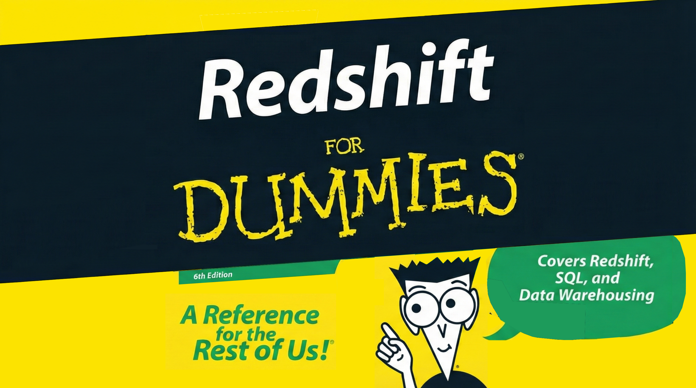

Slide 2

What’s data warehouse
A brief context for those who are not from the data world
It’s a system optimized for analytics — not for transactions. Instead of handling single records like OLTP databases, a data warehouse handles huge scans, aggregations, and complex queries across millions/billions of rows.
https://docs.aws.amazon.com/redshift/latest/dg/c_intro_about_redshift.html

Slide 3
What’s Redshift
Brief description of what RedShift is
Redshift is AWS’s fully managed data warehouse optimized for massive parallel processing (MPP) and distributed columnar storage.
Infra/DevOps angle:
Scales compute separately (RA3)
Integrates with S3 as a “lakehouse”
Has cluster and serverless modes
Predictable performance with workload management
Add an image here > like the columnar redshift characteristic

Slide 4
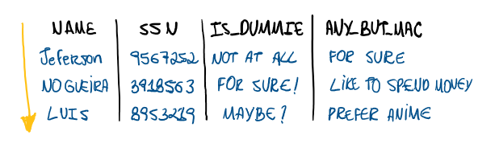

Slide 5


Slide 6
When using Redshift
Scenarios
An app stores data into redshift
What are the possibilities ?
What in Redshift is better or different than its competitors ?
Maybe talk about its horizontal table and what is better in this ?
✔ Analytics workloads
Dashboards, BI tools, year-over-year reports, etc.
✔ Multi-TB datasets
Example: logs, events, clickstreams.
✔ When you need SQL over S3 (Spectrum)
Query structured or semi-structured files directly in S3.
✔ When apps send data into Redshift
For example:
Event ingestion via Kinesis → Firehose → Redshift
ETL pipelines loading csv/json/parquet
CDC tables via DMS
What makes Redshift different?
Columnar storage → reduces IO drastically
Compression encodings → auto-optimized
MPP execution → runs queries across multiple nodes in parallel
Spectrum access to S3 → hybrid lakehouse
RA3 managed storage with hot cache → performance and cost win
Docs:
Spectrum: https://docs.aws.amazon.com/redshift/latest/dg/c-using-spectrum.html
RA3 architecture: https://aws.amazon.com/redshift/features/ra3/

Slide 7
When using Redshift
✔ Pros
Deep AWS ecosystem integration (Glue, S3, IAM, KMS, DMS, Firehose)
Spectrum for lakehouse queries
Mature, stable, predictable performance
Serverless mode reduces ops overhead
Columnar storage
Fast scans, heavy compression, less IO.
Sort Keys
Define how data is ordered, reducing query time.
Distribution Keys
Define how data is spread across nodes for parallel execution.
Spectrum
Query S3 directly.
Workload Management
Separate ETL vs BI vs ad-hoc users.
✘ Cons
Not ideal for OLTP or high write-per-second workloads
Requires understanding distribution/sort keys for best performance
Serverless costs can spike if not using usage limits
Heavy concurrency can require tuning WLM
Docs:
WLM: https://docs.aws.amazon.com/redshift/latest/dg/cm-c-wlm.html
Serverless limits: https://docs.aws.amazon.com/redshift/latest/mgmt/serverless-getting-started.html

Slide 8
Architecture
4.1 Cluster
Types of clusters
6.1 Cluster (Classic + RA3)
Short description of Redshift architecture:
Leader node: query planning
Compute nodes: distribute and process data
Columnar storage: compresses and speeds up scans
RA3: separates compute from managed storage
Docs:
Nodes/architecture: https://docs.aws.amazon.com/redshift/latest/dg/c_high_level_system_architecture.html
4.2 Serverless
Amazon Redshift Serverless adjusts capacity in seconds to deliver consistently high performance and simplified operations for even the most demanding and volatile workloads.
Key message, keep it short:
Redshift Serverless eliminates clusters. You just run SQL. Redshift automatically allocates compute (QPU) based on workload.
Why DevOps likes it:
No nodes to manage
Scales up/down within seconds
Integrated usage limits
Ideal for intermittent or unpredictable workloads
Docs:
https://docs.aws.amazon.com/redshift/latest/mgmt/serverless-whatis.html

Slide 9
Serverless
Scaling
How it works
Keep it simple:
Compute measured in RPU/QPU
Scaling based on query complexity/concurrency
Autoscaler adjusts in seconds
You can set max RPU to control cost
You can pause billing when no queries are running
Docs:
https://docs.aws.amazon.com/redshift/latest/mgmt/serverless-workload-management.html

Slide 10
Live Demo
A demonstration of data ingestion, processing and cluster scaling.
Suggested example flow:
Show a COPY command loading data (or Firehose ingestion).
Show a query running.
Show RPU scaling up in Serverless dashboard.

